Slide 1
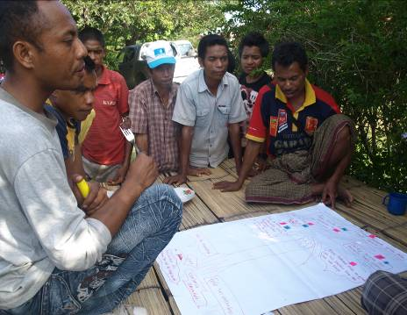
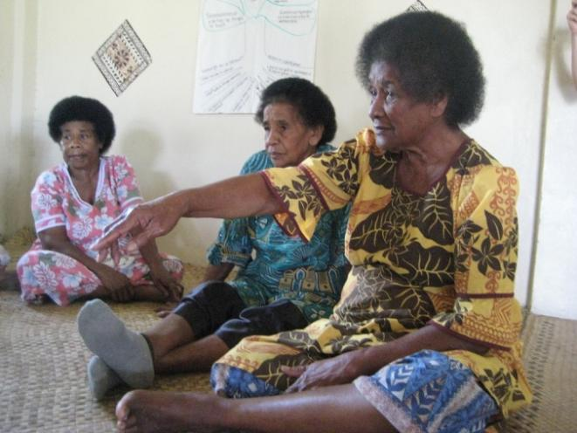
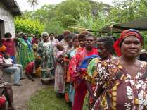


Inclusive WASH: Gender

Slide 2

Welcome and introductions
Di Kilsby Gender and Training Advisor at International Women's Development Agency
Dr Juliet Willetts and Naomi Carrard Institute for Sustainable Futures, University of Technology, Sydney
You! Please respond to the poll then introduce yourself using the chat

Slide 3
Webinar tools
Feedback – yes/no, slow down, speed up
Chat – left hand side of the screen
Polls – like the one you’ve just used

Slide 4
Webinar overview
Topic 1 What is gender about? Why is it important in WASH?
Topic 2 Changing gender roles and relations – you’re already doing it!
Topic 3 What do good gender outcomes look like in WASH programs?
Topic 4 Putting it into practice
Notes:
Juliet

Slide 5
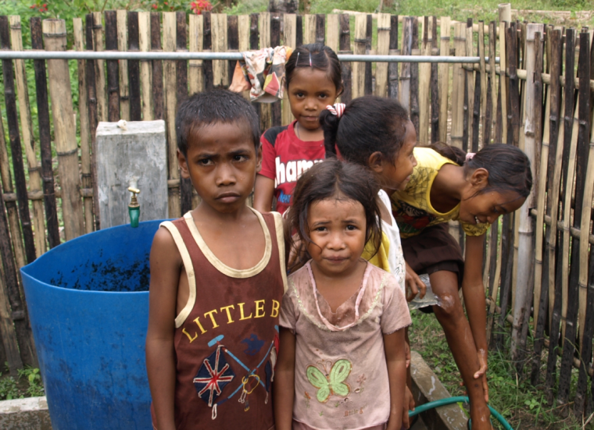
Topic 1
What is gender? Why is it important in WASH?

Slide 6
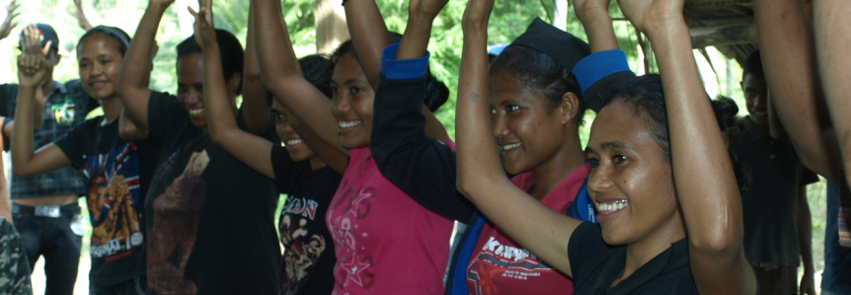
Inclusion of women and girls is about:
Understanding ‘gender’
Applying a gender lens
Doing gender analysis

Slide 7
What is ‘gender’?
Tell us what you think:
What do you think of when you hear the word ‘gender’? What does it mean to you?
What questions would you like to put to the forum?

Slide 8
What is ‘gender’ about? Basic definitions
Gender | This is a different from ‘sex’:
Identifies the social relations between men and women. It refers to the relationship between men and women, boys and girls. It also identifies how these relationships are socially constructed. Gender roles are dynamic and change over time. | Identifies the biological differences between men and women. For example, women can give birth, and men provide sperm. These sex roles are universal.

Slide 9
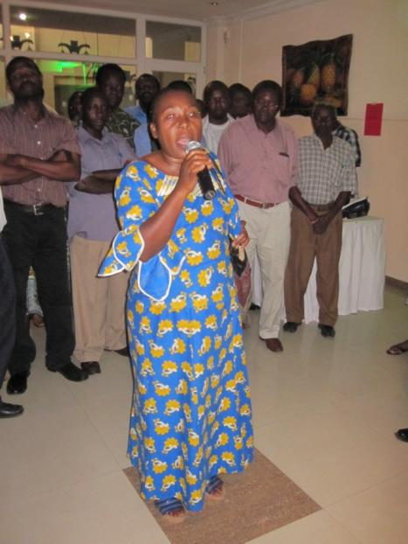
Let’s be clear what ‘gender’ is and is not about…
‘Gender’ is | ‘Gender’ is not
About both women and men – the different things that women and men do and the relationships between them | Only about women Only women’s responsibility A Western or foreign idea

Slide 10
Gender Mainstreaming
‘A common misunderstanding about gender mainstreaming is that it requires some sort of gender balance’ in any intervention, meaning an equal representation of women and men and not any women-specific project or components’.
- Smita Mishra Panda

Slide 11
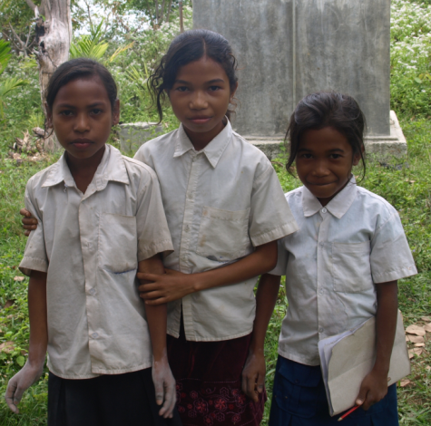
Two more essential
concepts
Gender equity | Gender equality
Is the process of being fair to women and men. To ensure fairness, measures must often be available to compensate for historical and social disadvantages that prevent women and men from otherwise operating on a level playing field. Equity leads to equality. (from Gender-Based Analysis: A Guide for Policy Making, Status of Women, Canada, 1996) | Means that women and men enjoy the same status. Gender equality means that women and men have equal conditions for realising their full human rights and potential and to benefit from the results. Gender equality is therefore the equal valuing by society of bot the similarities and differences between women and men, and the varying roles that they play. (from Gender-Based Analysis: A Guide for Policy Making, Status of Women, Canada, 1996)

Slide 12
Why is gender important?
Why do we need to think about gender?
There are socially determined differences between men and women based on learned behaviour, which affect their ability to access and control resources
Access and control are also determined by other factors such as: class, ethnicity, age, (dis)ability, location, sexuality, nationality etc.
Gender awareness is about recognising that...
Women and men have different needs based on their different roles
Structural inequalities exist in every society that disadvantage women on social, political and economic levels.
Women’s needs and rights are often made invisible or ignored
Men can also be negatively affected because of social expectations of how they should behave and what they should achieve.
The contributions of both men and women are needed for positive and lasting change

Slide 13
Gender Equality: International Obligations
1979 United Nations Convention on the Elimination of all forms of Discrimination against Women (CEDAW),
1994 Cairo International Conference on Population and Development Programme of Action (strong focus on women's rights)
  Gender is referred to as a locus of discrimination under many Conventions
  Gender equality is critical to the achievement of rights outlined in all Rights Conventions
1995 Beijing Platform for Action of 4th UN World Conference on Women
1999 Optional Protocol to the Convention on the Elimination of All Forms of Discrimination against Women
2000 Resolution 1325 on Women, Peace and Security
AND: Gender Equality is one of the MDGs (MDG 3)

Slide 14
Inclusion of women and girls… which women and girls?
All women and girls are not the same:
Think about women in urban or rural areas; women with disabilities; adolsecent girls, young adult women and elder women; women who are in powerful families or women in very poor families; women with HIV and AIDs, women as carers for family members with HIV and AIDS… just a few examples
Beware of myths and stereotypes:
Women are often given the role of treasurer on community committees because it is assumed they are more trustworthy… but should we also work to make men more accountable?
Women are often seen as passive, subservient – as victims needing help, needing to ‘be empowered’. In reality, women are powerful agents of change. (One article by B. Crow and J. MckPike mentions women’s activism for WASH rights in India, Bangladesh, Iraq, Bolivia, Nicaragua, Mexico, Argentina and Kenya.

Slide 15
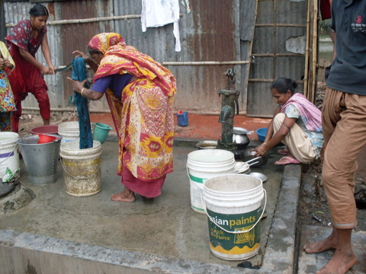
Gender in WASH
Do you think gender is important in WASH? Why?
Answer the poll question!

Slide 16
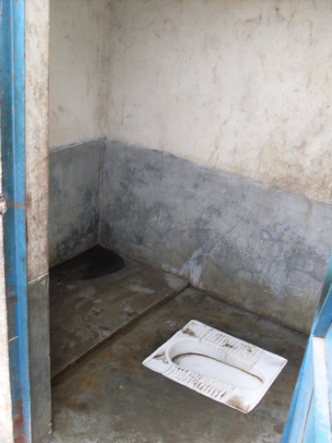
Focusing on gender is important for WASH because…
… we need to ensure infrastructure and services meet everyone’s needs.
Benefits of a gender focus | Risks of not making gender a focus
The different needs of women, men, girls and boys are met For instance, Providing room within a toilet for menstrual hygiene needs Women are happy with the type and placement of facilities they will use Toilets may not feel easy to use for men | Specific needs of different groups in the community are not met, which prevents realising communal WASH benefits For instance, Women’s safety and security may be compromised Certain groups, for instance pregnant women, may find using facilities difficult

Slide 17
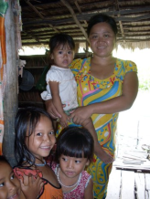
Focusing on gender is important for WASH because…
…it can increase sustainability of outcomes.
Benefits of a gender focus | Risks of not making gender a focus
Equal involvement of women and men has been correlated with improved sustainability of WASH programs (Narayan 1995) For instance, - Women’s contribution to management decisions may assist in better decisions that represent views of both women and men | Poor sustainability is a critical risk in the WASH sector, not making gender a focus increases this risk For instance, - Facilities that are not appropriate for women or men’s use may fall into disrepair

Slide 18
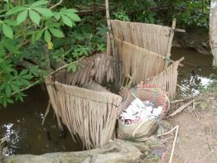
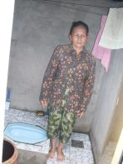
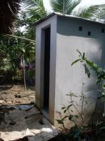
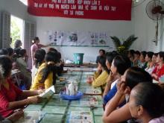
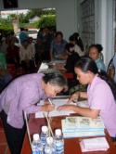
Focusing on gender is important for WASH because…
…women are the most motivated about WASH
Benefits of a gender focus | Risks of not making gender a focus
Women are primary users and managers of WASH, so are well placed to contribute to planning, decision making and management For instance, Women, if supported, may take big steps to convince their husbands to invest in a toilet | Women’s perspective and potential role may be missed. For instance, - If just men are asked about what is important in terms of community needs, WASH needs may even be overlooked. - The priority of a WASH project in a community may be reduced.

Slide 19
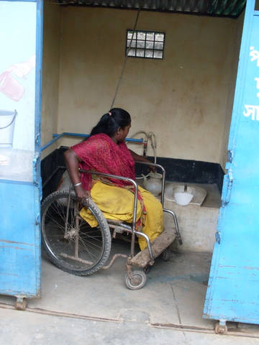
Focusing on gender is important for WASH because…
… then the benefits will be equitably shared.
Benefits of a gender focus | Risks of not making gender a focus
All in the community can participate and benefit from WASH programs For instance, Due to women and men’s inputs to design, the facility designs will meet everyone’s needs | Benefits may flow to one or more groups but not all, creating inequities and potential conflict For instance, - Due to positioning of water access, women may have to wash themselves in a public area and as such may not use the facilities

Slide 20
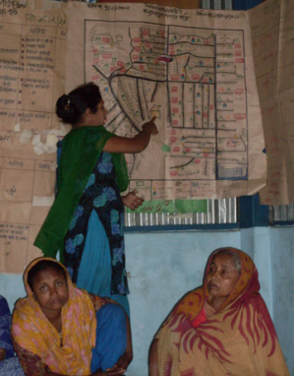
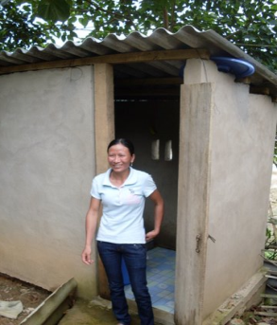
Focusing on gender is important for WASH because…
… it offers an opportunity to advance gender equality.
Benefits of a gender focus | Risks of not making gender a focus
WASH programs can achieve positive outcomes for women, men and relationships generally, increasing equity and creating opportunities for participation For instance, Women may be able to start taking on leadership roles | Existing inequalities may be entrenched or made worse For instance, - Women’s work may increase, for instance if a water-based toilet is installed that requires additional water to be collected and this work falls to women.

Slide 21
Gender & WASH in international policy
First mentions: 1977 United Nations Water Conference at Mar del Plata and the International Drinking Water Supply and Sanitation Decade, 1981-1990.
Dublin principles 1992: “Women play a central part in the provision, management and safeguarding of water.”
Rio Conference 1992: woman as environmental managers
Millennium Development Goals: Gender equality and WASH in separate MDGs
Johannesburg 2002 (Rio+20): plan of implementation commits governments to “…support capacity building for water and sanitation infrastructure and services development, ensuring that such infrastructure and services …are gender-sensitive.”
International Decade for Action on Water for Life 2005-2015: “…striving to ensure women’s participation and involvement in the water-related development efforts.”

Slide 22
Gender & WASH in international policy
First mentions
Dublin principles 1992
Rio Conference 1992
Millennium Development Goals
Johannesburg 2002 (Rio+20)
International Decade for Action on Water for Life 2005-2015
Recognising the important place of women
Gender sensitive… how?
Water focus… Sanitation? Hygiene?
Capacity building, participation, involvement
More a focus on women…less on roles, relationships and power

Slide 23
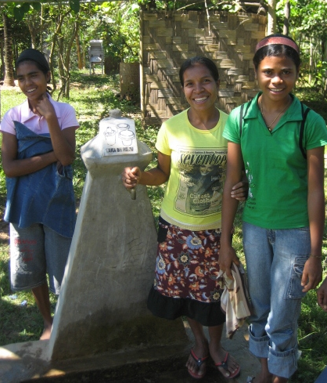
Topic 2
Changing gender roles and relations: You’re already doing it!

Slide 24
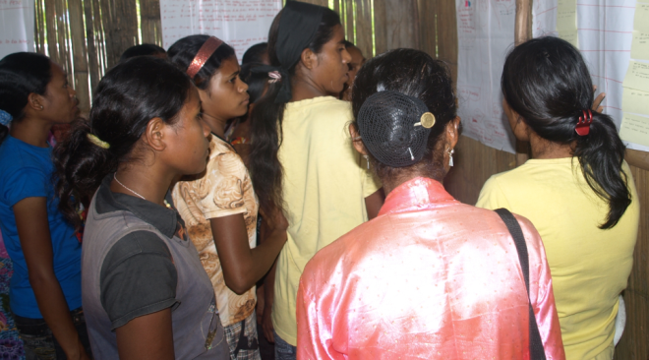
Everything that involves people is gendered…
… because women and men have different roles, opportunities, vulnerabilities and life experiences…
… So: Everything we do will have a gendered impact
(whether or not we think about it)

Slide 25
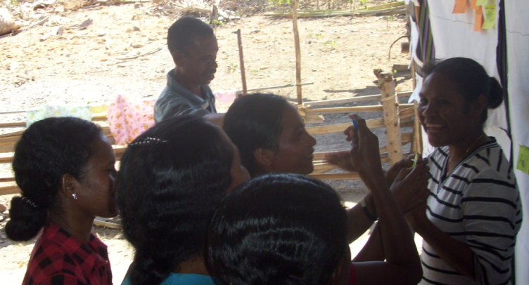
Gendered impacts of WASH
Tell us what you think:
Do you know what the gendered outcomes are of your work?

Slide 26
Talking about gender: ‘we can’t change that, that’s culture’
People often fear that tackling gender inequality may be inappropriate because it challenges ‘tradition’ and ‘culture – but:
‘What is seen as “the culture” may in fact be a viewpoint held by a small group of elites keen to hold onto their power and status.’
- From UNFPA State of the World’s Population 2008, Reaching Common Ground: Culture, Gender and Human Rights
‘Washing one’s hands of the conflict between the powerful and the powerless means to side with the powerful, not to be neutral.’
- Paulo Freire

Slide 27
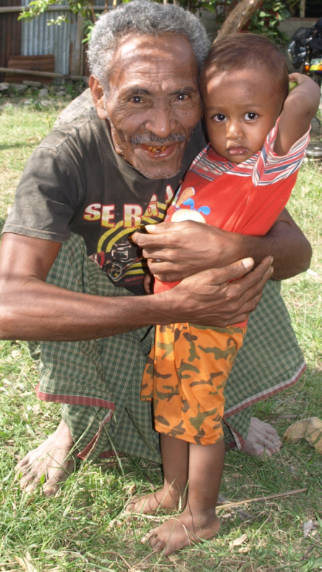
Gender and culture
It can be difficult for people in both NGOs and communities to take on different gender roles
Women and men – insiders as well as outsiders - who challenge gender inequality may be accused of ‘tampering with the culture’ or ‘imposing “Western” values
Challenging power relations can be difficult and can lead to conflict – needs a careful approach

Slide 28
Gender and culture: Remember that…
Cultures are always changing due to external and internal factors
All of development work and WASH work is about change: changing attitudes, behaviour and institutions – all of this involves changing ‘culture. Addressing gender inequality is no different from any other change process.
Using a strengths-based approach can encourage people to think and talk about their culture and values and to be open to changing
‘Development should not disregard existing traditional social order but seek to transform it.’
from Soetan, RO, 2001, Culture, Gender and Development: A report submitted to the
African Institute for Economic Development and Planning (IDEP), Dakar, Senegal

Slide 29
Gender and culture: Remember that…
Sometimes change in the environment can reinforce gender inequalities and exacerbate women’s disadvantage:
‘Although toting water for families is considered to be the work of women and children, when it comes to toting water for pay, young men monopolise the work – using wheelbarrows and bicycles however, and not head loads!’
Source: Tanzania Gender Networking Program
So it is important that we consider the gender implications of everything we do.

Slide 30
Gender at different levels
Gender inequality needs to be addressed at all levels – family, community, in organisations, from local to national level
‘Needless to say that the household is the most complicated site and many efforts need to be initiated here to bring changes in gender relations’
- Smita Mishra Panda

Slide 31
How WASH impacts on gender roles and relations
Look for more stories in the resource material on the Gender Page of the Inclusive WASH website. There are many case studies in:
For Her It’s the Big Issue Evidence Report
UNDP and GWA’s Mainstreaming Gender in Water Management Resource Guide

Slide 32
Topic 3: What do good gender outcomes look like?
Have you made gender a focus of your WASH work? What did you do? How did it go?

Slide 33
Different kinds of gender outcomes
Practical gender needs are those related to needs that arise from women’s usual roles and labour
Strategic gender interests address and challenge the power relations between women and men

Slide 34





Some of the following examples are drawn from research in the Pacific and East Timor... others are based on other studies of links between gender and WASH

Slide 35
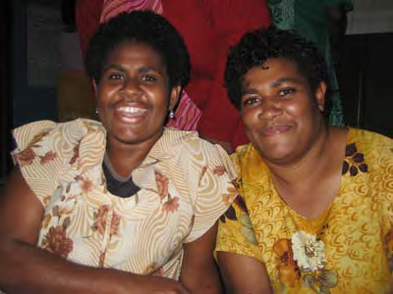
Women had gained respect through taking action...
‘The response to women has changed, they are more listened to, there is more trust of women. Whatever project women take a lead in, it is a success. For example in health issues, drainage, compost. Women have gained respect’ (Senikau village, woman)

Slide 36
and because men recognised their contribution...
‘Men acknowledge the amount of work the women have done and their role... the change is the recognition (Senikau villiage, man)

Slide 37
and because men recognised their contribution...
‘Men acknowledge the amount of work the women have done and their role... the change is the recognition (Senikau villiage, man)
Would you say this is a ‘practical gender needs’ change, potentially strategic, or strategic?

Slide 38
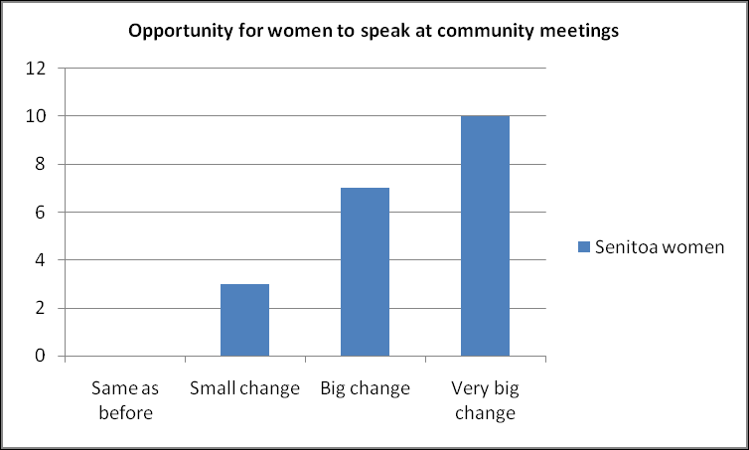
Increased respect led to increased voice...
Opportunity for women to speak at meetings
  ‘Previously during the meetings the men would tell us we are women so we can’t talk and we remain silent, but now we are talking’ (Nanen woman).

Slide 39
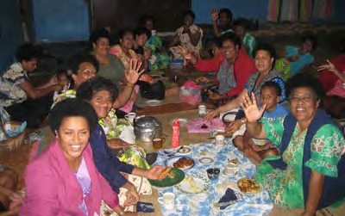
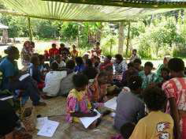
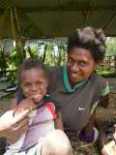
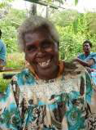
Increased respect and voice led to increased confidence ...
Women working together collectively, women on committees and women influencing decisions
  We used to be scattered and not working together [with other women], now we have representation in the committee. Now women start to talk in meetings, now there are women who help take decisions. Before women didn’t talk in community meetings, now they participate and also take decisions. It makes me so proud that we have a voice in development. (Puluan woman).

Slide 40
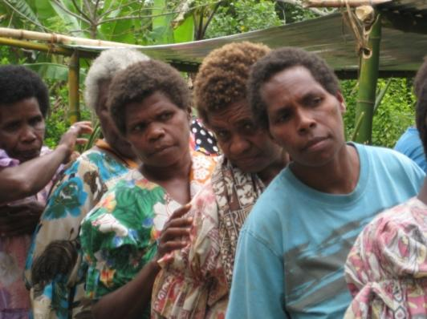
Women’s labour is reduced
  ‘Life is easier now that we no longer go far distances. Now we can wash our clothes at home’ (Puluan woman).

Slide 41
Women’s labour is reduced
  ‘Life is easier now that we no longer go far distances. Now we can wash our clothes at home’ (Puluan woman).
Is this a ‘practical gender needs’ change, potentially strategic, or strategic?

Slide 42
And men help more with water collection and household tasks
‘This is the reality in my family that when water is exist in the community (ie near the house), men also help to fetch water.’ (Timorese woman)

Slide 43
Women experiencing leadership roles for the first time...
‘I was the treasurer last year for the community [water] committee. I was very proud. The men had chosen me and voted for me. I was very proud as I was the first and only woman to be on the committee… the community trusted me and gave me this position of high trust. It made me feel proud to be a woman. I was the first lady to have a position of responsibility.
(Nanen, female water committee member)

Slide 44
And changes in women and men’s attitude to women’s leadership…
In Nanen, 92% of men and 89% of women considered it important or very important for women to be on the committee.
In Puluan all women and all men considered it important that women be on the water and sanitation committee.
‘I was elected to the committee and am very proud, it is unusual to have a woman on a committee and contribute to decisions e.g. about payment for water etc. I feel more respected by my husband …. In my family the relationship is improved and I am happier’
(Puluan, female water committee member)

Slide 45
And changes in women and men’s attitude to women’s leadership…
In Nanen, 92% of men and 89% of women considered it important or very important for women to be on the committee.
In Puluan all women and all men considered it important that women be on the water and sanitation committee.
‘I was elected to the committee and am very proud, it is unusual to have a woman on a committee and contribute to decisions e.g. about payment for water etc. I feel more respected by my husband …. In my family the relationship is improved and I am happier’
(Puluan, female water committee member)
Would you say this is a ‘practical gender needs’ change, potentially strategic, or strategic?

Slide 46
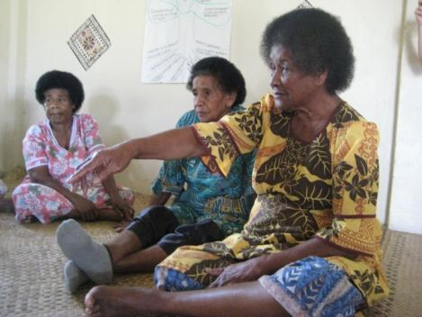
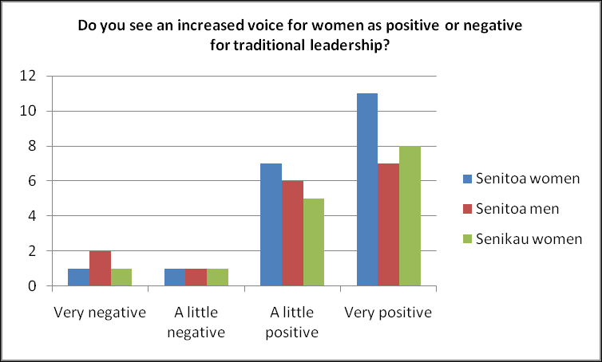
More changes in attitude...

Slide 47
Women experience more harmony in the home:
‘Once fetching water from long distance, we came home late our husband angry, but now, no more – the food can be quickly and well prepared, and we feel love in the family and love for our children.’ (Timorese woman)

Slide 48
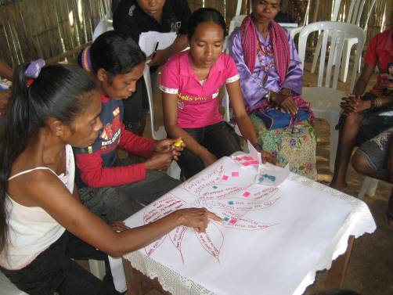
Increase in freedom and opportunity
  Women expressed feeling greater sense of freedom and opportunity and many expressed greater happiness
  ‘Once we had no water our husbands did not allow us to go to the parties. But now they allow us take part in the neighbour’s parties.’ (East Timor)

Slide 49
Income opportunities and freeing up time
A study in India by IRC/FPI showed many benefits for women:
“the maximum additional income a woman can earn assuming time saved is devoted to economic activities could be 750-5520 rupees per woman”
(GWA, undated)
“time freed for personal, domestic, social on development activities was 45-152 8-hour days” (GWA, undated)

Slide 50
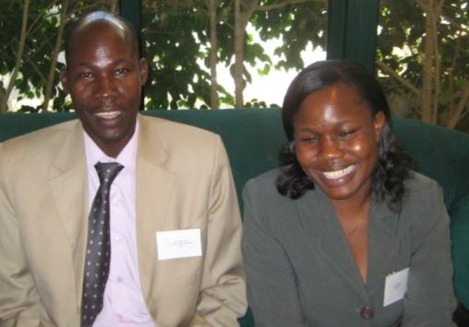
Increased school attendance and confidence
Plan International in Uganda is seeing an increase in school attendance and also confidence in girls resulting from a project focusing on making affordable sanitary pads for girls in schools
“Plan Uganda is starting to document testimonies of girls staying in school during their menstrual period, feeling able to share their concerns with senior women teachers and asking for assistance”
(Plan Uganda in Carrard 2010)

Slide 51
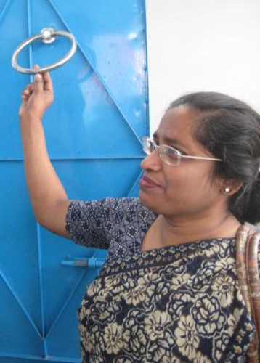
Increase in participation, voice and confidence
An increase in participation and confidence is being seen in a WaterAid in Bangladesh program.
“adolescents can now voice their needs…the women also have direct access as they are in the committee. So they can say what they need separately for their own dignity and privacy…So now there are new leaders working with old leaders, working together”
(PSTC/WaterAid in Carrard 2010)

Slide 52
Employment, reduced labour and increased representation
An impact assessment (using gender disaggregated data) of a small town water supply project in Uganda identified practical and potentially strategic outcomes
A reduction in both time and money spent collecting water, with children spending more time studying as a result (WSP, 2010)
Increased employment opportunities for women and diversification of income sources (WSP, 2010)
An increase in representation of women on water/sewerage boards and also town councils
(WSP, 2010)

Slide 53
Different kinds of gender outcomes
So both
Practical gender needs
Strategic gender interests
can be achieved in WASH initiatives...
Why is this?

Slide 54
Enablers – things that the NGOs did that helped...(Live and Learn and WV)...
used water as an entry point to talk about governance, leadership and inclusion
paid particular attention to the needs of women when deciding timing and locations of project activities.
actively encouraged women to participate in meetings at all levels to voice their issues and concerns (rather than being represented by others)
worked carefully with male community leaders to ensure women and their participation were supported.
used pictures which made activities accessible to those low literacy groups (particularly the women).
used a 24h clock to raise awareness of the division of labour between women and men and how equitably it was shared
constructed separate toilets and bathing spaces for women and men
Notes:
Juliet

Slide 55
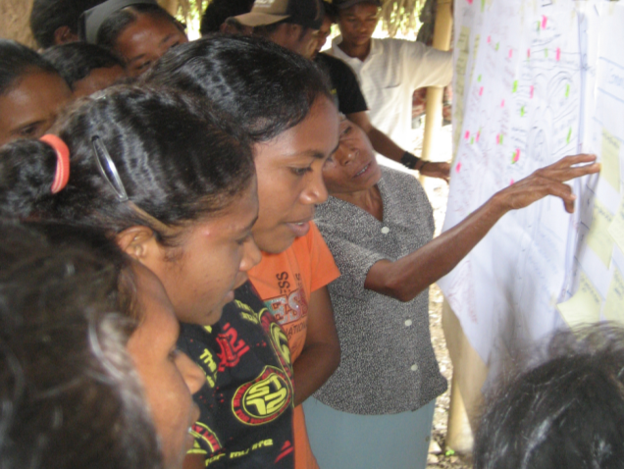
Enablers – things that the NGOs did that helped...(WaterAid)...
Made a conscious effort to include women on committees
Women staff (WaterAid and partner organisations) were important role models encouraging greater respect for women’s leadership potential and encouraging women to believe in their own capacities
Increased community awareness of women’s rights (many contributors:
NGOs and govt)
Supported women’s participation in decision-making to feed into positive cycle of change: women and men observe the value of women’s contribution which leads to growing acceptance and motivation to continue increasing women’s participation
Notes:
?

Slide 56
Enablers: the community strengths that assisted, according to women and men were...
Women worked hard and ‘from the heart’ and were ‘true to the task they were undertaking’
Women were willing to share skills with each other and work together
Women identified a commitment to spirituality and respect for household and community leadership as underlying strengths.
Women said that recognising their own contribution at the community level provided the foundation for positive outcomes
Men stressed the importance to having new ideas introduced into the community- they were open to change
Having strong role models was important, eg. respected men taking a stronger role in the home
The men also emphasised spirituality and the church as underpinning the positive outcomes achieved and felt that the influence of the church had contributed to changing their attitude.

Slide 57
Topic 4: Putting it into practice
What tools and techniques have you used to work effectively with women and men? Do you have any tools or tips to share?
Poll question
Please add information to the chat and we can upload resources and links after the webinar

Slide 58
Focus on ways of working that enable women, men, girls and boys to be actively involved in improving their water, sanitation and hygiene situation.
Principle 1: Facilitate participation and inclusion
Principles drawn from: Working effectively with women and men in water, sanitation and hygiene programs , Halcrow et al, 2010

Slide 59
Principle 2: Focus on how decisions are made
Use decision-making processes that enable women’s and men’s active involvement, within the project and in activities.

Slide 60
See, understand and value the different work, skills and concerns of women and men related to water, sanitation and hygiene.
Principle 3: See and value differences

Slide 61
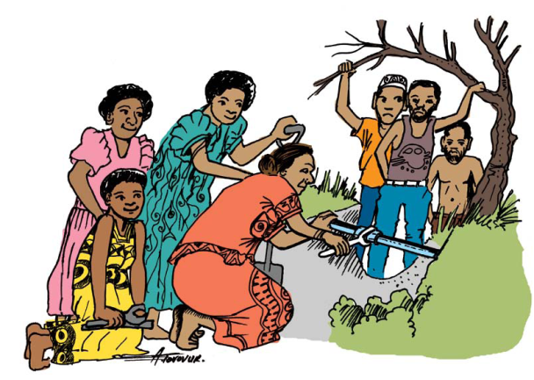
Provide space and support for women and men to experience and share new roles and responsibilities.
Principle 4: Create opportunities

Slide 62
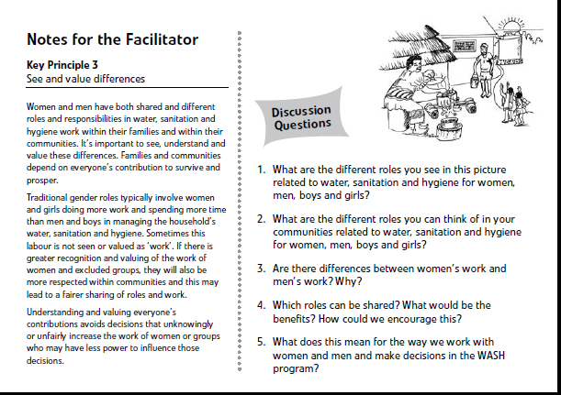
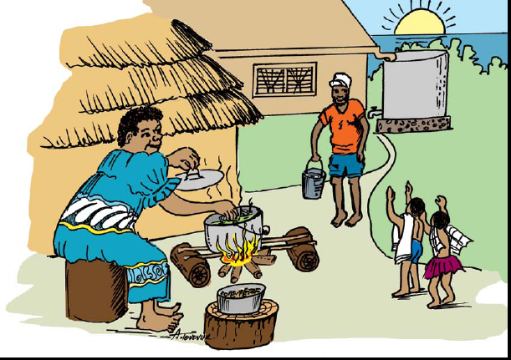
Some practical tools

Slide 63
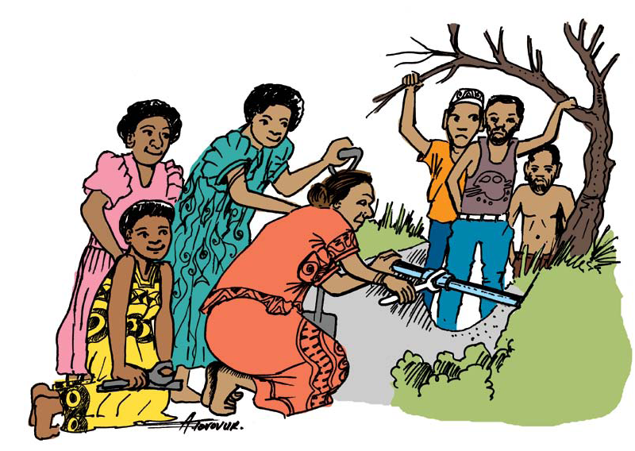

Slide 64
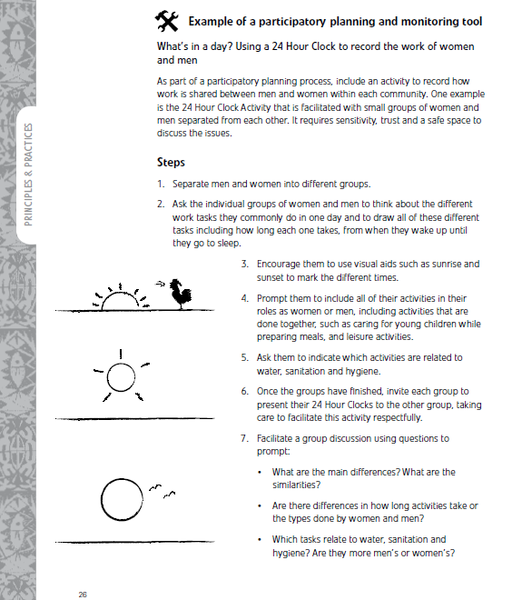
Addressing gender in WASH projects is DO-ABLE, and can be done in a constructive manner

Slide 65


More practical guides for gender in WASH programming:
More useful guides can be found among the resources on the Gender Page of the Inclusive WASH site:
Chapter 4 of the UNDP GWA Resource Guide on Mainstreaming Gender in Water Management
Section 6 – A minimum agenda for gender mainstreaming in water management, in Effective gender mainstreaming in water management for sustainable livelihoods: from guidelines to practice, a Both Ends Working Paper

Slide 66
Gender-responsive programming happens in gender-responsive organisations
See these resources on the Gender Page of the Inclusive WASH website
Chapter 5 of the UNDP GWA Resource Guide on Mainstreaming Gender in Water Management
Understanding gender equality in organisations: A tool for assessment and action by Juliet Hunt

Slide 67
Summary
Gender is important for WASH ⇨ There are many benefits from bringing a gender perspective to WASH, and also risks if you don’t make gender a focus
You are already changing gender roles and relations ⇨ So make the change positive!
What do good gender outcomes look like? ⇨ Many and varied, meeting practical needs and strategic interests
Putting it into practice ⇨ It’s DO-ABLE and can be done in a practical, constructive way

Slide 68


Over to you!
Please share your practical tools and tips
Share experiences you have bringing a gender perspective to your WASH work
Add questions to the discussion forum and we can continue conversations over the coming week
Thanks for your participation today!

