Slide 1

Disability Inclusion within WASH Programs
Case studies
Clare Hanley
CBM-Nossal Partnership for Disability Inclusive Development
Notes:
Thank everyone for joining the session
Introduce self and background
Brief overview of how to participate in the session – chat, raising your hand, polling questions
May have a range of participants for who English is a second language so please let me know using the chat function if I am speaking too quickly.

Slide 2
What type of organisation are you from?
A: An organisation implementing projects in the field (e.g. local NGO)
B: An organisation supporting others to implement projects (e.g. international NGO)
C: A donor organisation (e.g. government)
D: A research institute
E: Other

Slide 3
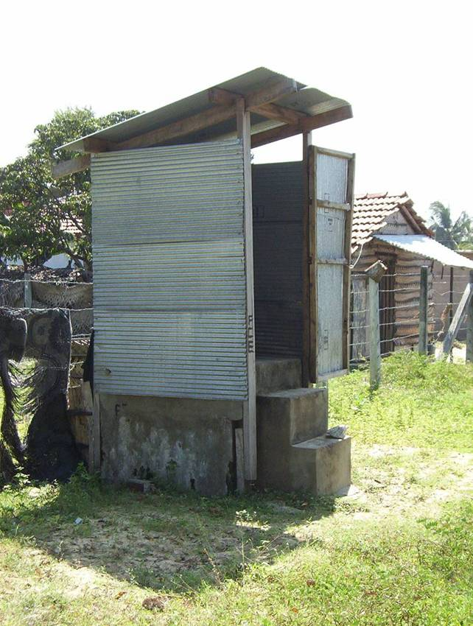
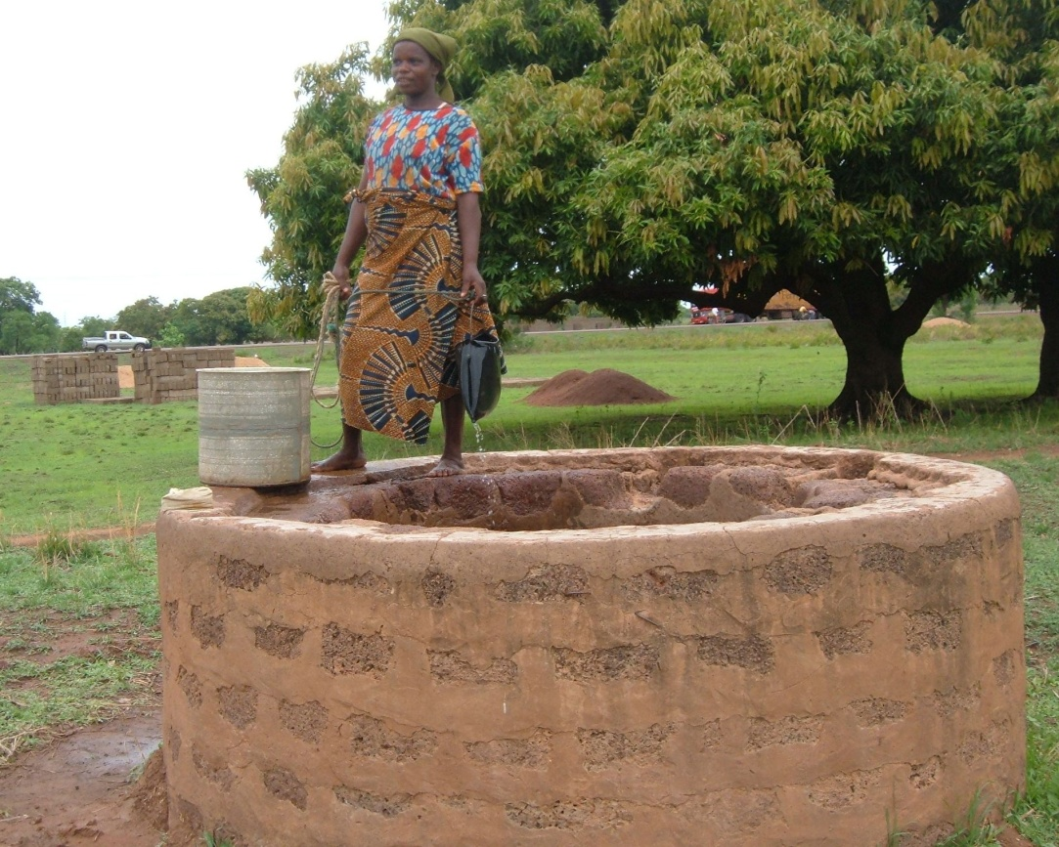
Revision from last week
Typical WASH infrastructure
Definition of disability and social model of disability
Barriers to inclusion – physical, attitudinal, institutional
Strategies to
overcome barriers
Photo: HI Sri Lanka
Photo: ADD Ghana
Notes:
Looked at a range of WASH infrastructure and how it is currently unaccessible for people with disabilities
Definition of disability as the interaction between somebody’s impairment and the environment that person lives in.

Slide 4
Structure of this session
Three case studies of programs that have taken a disability-inclusive approach:
Zimbabwe: Muzarabani WASH Project – World Vision
Tanzania: Kisarawe Water, Sanitation & Hygiene Project Phase 2 – Plan International
Bangladesh: Disability Inclusive Disaster Preparedness Project – Centre for Disability in Development
Notes:
Hazel covered some of the basic theory last week about disability inclusive WASH – why it is important and some principles to consider when designing programs
This session will expand on that content through three case studies that vary in terms of disability inclusion from a basic level, whereby people with disabilities are beneficiaries of the project to a more comprehensive approach whereby people with disabilities are active participants in the project.
If you have questions please raise your hand or please type them into the chat – If I can’t answer them, I will contact the organisation that provided me with the case study and provide the answer on the online forum

Slide 5
Case study 1
Mazarabani WASH Project Zimbabwe
Implemented by World Vision with funding from AusAID
Objective: to improve the health and quality of life amongst poor and vulnerable children and communities by improving access to water, sanitation services and promotion of good hygiene practices.
Key Activities:
VIP latrines constructed with hand washing facilities in households and schools
Construction and rehabilitation boreholes and wells
Participatory Health and Hygiene Education (PHHE) sessions

Slide 6
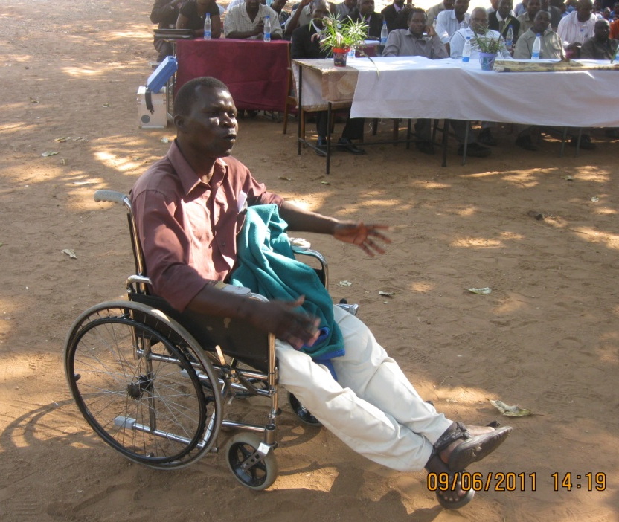
Strategies for Inclusion
Prioritised households with a person with a disability for latrine construction
Received technical assistance from the Disabled Association of Zimbabwe
Water points constructed close to households with a member with a disability
Photo: World Vision
Households with a member with a disability were targeted for monitoring
Hygiene education training for village health workers included information on disability-inclusive WASH
Notes:
People with disabilities were selected as a target group in this project because project staff identified that they had been excluded from previous projects. One person with a disability participated in identifying and selecting 40 households with a member with a disability.
Received technical assistance from the Disabled Association of Zimbabwe to develop accessible toilets in schools
Water points were constructed close to households with a member with a disability where possible
Households with a member with a disability were targeted for monitoring to ensure that latrines had been designed in a user-friendly way
Village health workers were trained in hygiene education for the project – this included training about the WASH needs of PWD in accessing WASH infrastructure.

Slide 7
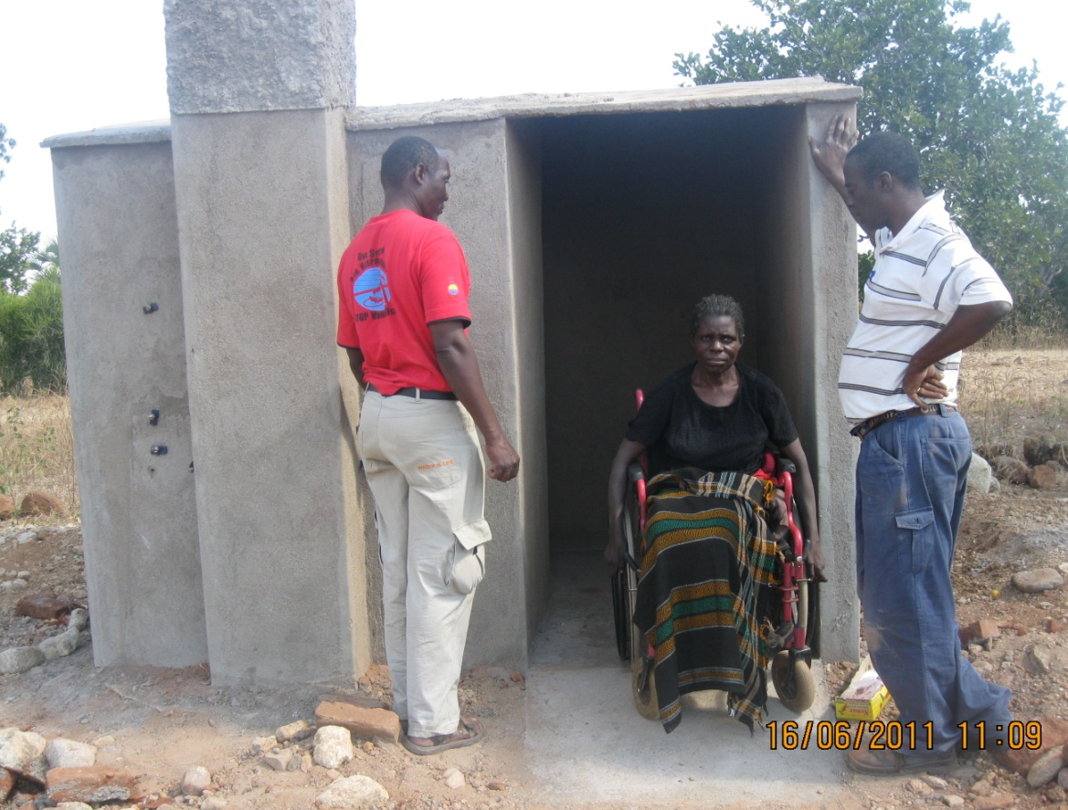
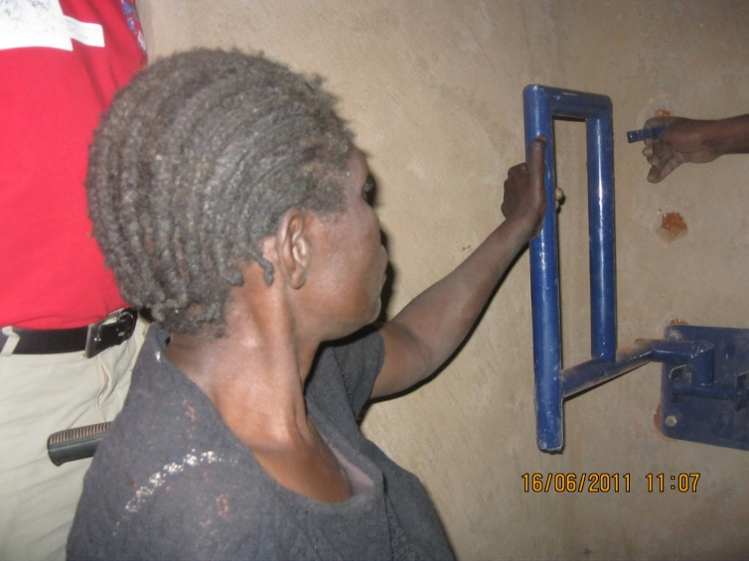
Outcomes
Disability accessible WASH infrastructure
Photo: World Vision
A community member testing access to a newly constructed latrine
Photo: World Vision
Notes:
Ask if anyone would like to comment on the strengths of this approach or whether they think anything was missing in terms of how the project sought to become disability-inclusive?

Slide 8
Challenges and lessons learnt
Challenges
Physical accessibility was a major barrier
PWD not included in community consultations or in decision making roles
Difficult to mobilise the community to assist in constructing latrines
Lessons learnt
People with disabilities were beneficiaries of the project but not active participants
Additional steps/activities may need to be incorporated into future projects to increase inclusion.
What would you do differently?
Notes:
Physical accessibility was a major barrier to PWD’s participation:
PWD could not participate in the final project evaluation as no appropriate transport could be found to assist people to attend
PWD not included in community consultations around the project’s design or in decision making roles through the project - PWD not included in water point user committees – on reflection, the major barrier identified physical accessibility in that many PWD within the project area were either unable or did not feel able to leave their homes
Community members were reluctant to change the locations of community gatherings / consultations that may have made it more accessible for PwDs to attend, indicating that they did not recognise the benefits in consulting PwDs.
The project was designed so that households needed to provide some labour and materials for the construction of latrines – this was difficult for households with people with disabilities. Community was reluctant at first but with encouragement from local leadership eventually volunteered their time
Lessons learnt:
Through working with me to prepare this case study the World Vision team in Zimbabwe reflected that while they thought this project was disability-inclusive (and it was to an extent), much more needed to be done to fully include PWD as participants rather than just beneficiaries.
Ask audience: What would you do differently?
Additional activities that could have been considered include:
partnering with a DPO to undertake disability-awareness raising activities within the community and water point user committees to highlight why it is important for PWD to participate.
Visiting households with PWD to encourage their involvement and working with them to identify and overcome barriers – PWD may need some training or support to feel confident to speak their opinions
Partnering with a disability organisation or rehabilitation service provider to assist people to access assistive devices to improve their mobility

Slide 9
Case study 2
Kisarawe Water, Sanitation & Hygiene – Phase 2, Tanzania
Plan Tanzania with support from Plan Australia
Project Objectives:
Improved access to adequate supplies of safe water
Increased adoption of hygiene and environmental sanitation practices.
Improved access to safe WASH facilities and increased adoption of environmental health practices in schools.
Strengthened ability of Local Government and communities to sustainably lead, manage and implement District WASH initiatives.
Notes:
Kisarawe Water, Sanitation & Hygiene – Phase 2, Tanzania
Implemented by Plan Tanzania with support from Plan Australia
Timeframe: April 2009 – March 2012
Project Objectives:
Improved access to adequate supplies of safe water among 22,400 women, children and men
Increased adoption of hygiene and environmental sanitation practices in 55 villages.
Improved access to safe water supplies, sanitation facilities and increased adoption of environmental health practices in 12 schools.
Strengthened ability of Local Government and communities to sustainably lead, manage and implement District WASH initiatives.

Slide 10
Context for PWD
Baseline study conducted by Youth Disabled Development Foundation:
144 people with disabilities identified
Water and sanitation facilities inadequate for PWD at household and community level
Difficulties reported in accessing toilets
A mix of positive attitudes towards PWD and negative – particularly toward albinos
Limited awareness about rights of PWD
Notes:
144 people with disabilities identified in project areas
Water and sanitation facilities inadequate for PWD at household and community level
Difficulties reported in accessing toilet – steps, no handrails, not enough space to turn around, doorways too narrow etc
A mix of positive attitudes towards PWD and negative – particularly toward albinos. PWD seen to need looking after and charity
Limited awareness in the community about rights of PWD

Slide 11
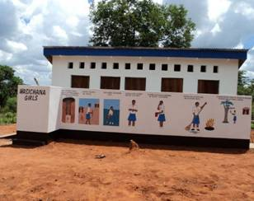
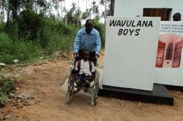
Strategies for inclusion
Baseline assessment
School WASH facilities were designed to be disability-accessible using WEDC handbook
Disability awareness training conducted
Photo: Plan
Newly constructed universally-designed school latrines
Photo: Plan
Plan Tanzania WASH Advisor ‘testing’ latrine block with a student
Notes:
Disability and gender were considered under the framework of social inclusion - considered throughout the planning and implementation of this project.
By conducting a baseline assessment, PWD were consulted and their views informed the design of the project.
School WASH facilities were designed to be disability-accessible using WEDC handbook
Disability awareness training incorporated into training for project team, water management committees and CLTS task forces
The project formed a partnership with The local DPO participated in annual project planning and review meetings
Theatre and dance was used to raise awareness about disability and gender within communities – starting to get the feel of a twin track approach (disability-specific activities as well as mainstreaming)
This has helped the community accept people with disabilities and be more receptive to their participation.
DPO accompanied the theatre group on these sessions – having PWD as part of these sessions made them more effective – one community member expressed during a focus group that he was surprised to see someone with a disability speaking so well to the community.

Slide 12
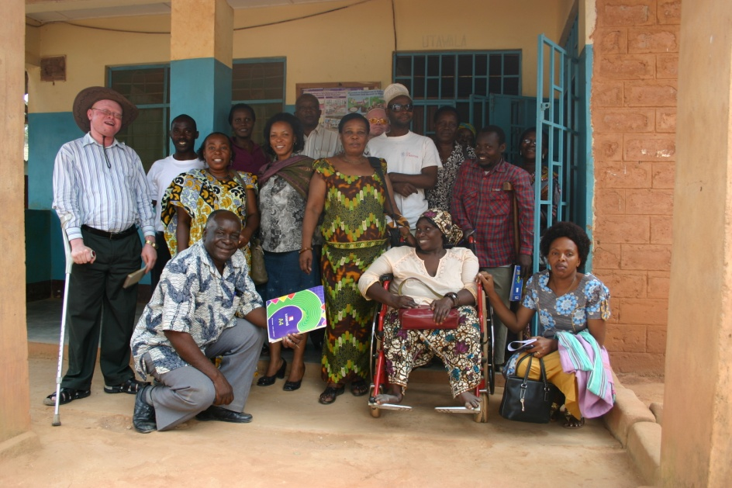
Strategies for
inclusion cont..
Partnership with SHIVYAYAWATA (Disabled Person’s Organisation)
Drama was used to raise awareness about disability and gender within communities (with support from DPO)
Gender and disability champions were nominated from different stakeholder groups – local government, teachers, community members, Plan Tanzania staff
What are the strengths of this approach?
Photo: Plan
Plan Tanzania, IGN-K and SHIVYAWATA after a meeting
Notes:
Ask audience: What are the strengths of this approach? Any key components of developing a disability inclusive program that you think are missing?

Slide 13
Challenges and lessons to date
Getting PWD into decision making processes – committees etc.
Building the capacity of households to construct accessible toilets
Changing attitudes – this doesn’t happen overnight
  find champions within the community – both people with a disability and others
  Provide consistent messages in a range of different formats over a long period of time to allow people to think, process and respond
Notes:
Getting PWD into decision making processes has been challenging and remains a work in progress. Recently 1 water management committee had its first person with a disability join, after significant awareness raising etc within the community and committee.
It has been difficult to encourage households to modify toilets or incorporate accessibility features into designs for new toilets – particularly older people have been resistant to this. In some communities they are helping to build toilets for households with elderly people or PWD so they can achieve ODF status.
During awareness raising sessions, not all people within a community would suddenly understand and change their attitudes about disability – some would say “these people are disabled, why should we help them?” but others in the community did understand, and these became advocates.
In another village there was a man who had a disability and was also well-educated. When he spoke the community listened and began to understand that people with disabilities are able to do things around the village and have rights.
Find champions within the community – ideally people with disabilities, but also other passionate people – community leaders etc.
Remember that this is difficult and takes time – its much more effective for people to see and interact with people with disabilities and learn from them rather than others speaking on their behalf

Slide 14
Case study 3
Disability Inclusive disaster preparedness in Bangladesh
Implemented by Centre for Disability in Development (CDD) with local NGO Gono Unnayan Kendra (GUK)
Funded by CBM Australia and others
Objective 1: To pilot a project on Inclusive Disaster Preparedness within the local communities of Gaibanda district (Bangladesh), capturing lessons learnt and best practice principles.
A sub-component of this project was to improve water and sanitation
Notes:
Included this case study because it is a different type of project and is implemented by a disability organisation, meaning that disability inclusion is built into the goals of the project.
We will focus on the water and sanitation component

Slide 15
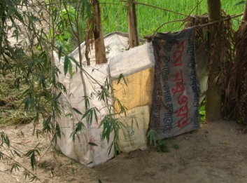
Context
Flood is very common for people in the region
The water and sanitation infrastructure and facilities in the project area were largely poor and unhygienic.
The local community used water
from tube wells, ponds and the
river
Neither the latrines or tube wells had
been constructed considering the
needs of people with disabilities
During flood, most of the latrines
and tube wells became submerged
Photo: CDD
A typical latrine in the project area
Notes:
Many of the existing latrines were temporary, vulnerable and difficult to use. It was very difficult to collect water from the river particularly in the dry season.
Most people with disabilities need to depend on their families for assistance using the toilet

Slide 16
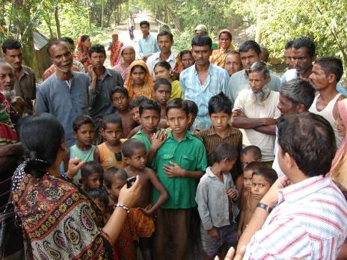
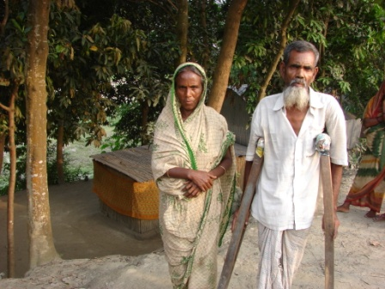
Program Design
  Program was designed in consultation with community
  A situational analysis was conducted to identify people with disabilities within the community and determine their needs
  One person with a disability commented: “we feel that our dignity is stripped each day when we need to use the toilet depending on others”
Photo: CDD
Community consultations
Photo: CDD
Notes:
Program was designed in consultation with the community, PWD, their families and local government
A situational analysis was conducted to identify people with disabilities within their communities. People with disabilities were identified by project staff through information provided by community people and home visits. The local partner NGO already had a relationship with the community and local government.
During situational analysis, people with disabilities were briefed on the project and encouraged to be involved.
One of the needs identified was access to safe water and sanitation during and after the disaster period.
One person with a disability commented: “we feel that our dignity is stripped each day when we need to use the toilet depending on others”

Slide 17
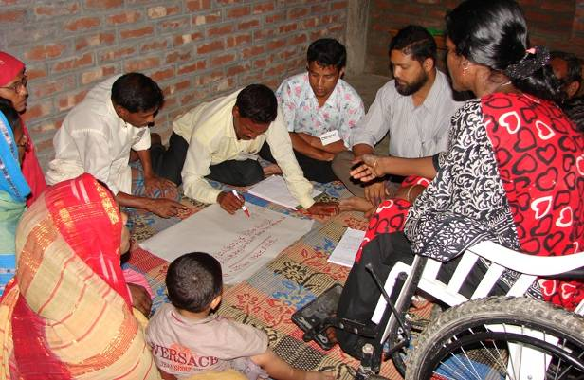
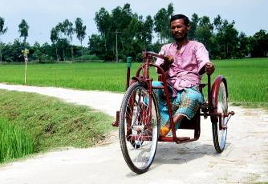
Key activities/Outputs
Training on disability awareness provided to Disaster Management Committees
Vulnerability and capacity assessment completed in communities
Photo: CDD
Disability awareness training to Ward Disaster Management Committee
assistive devices were provided to people with disability to improve their mobility
Photo: CDD
A community member with a new assistive device
Notes:
35 assistive devices were provided to people with disability to improve their mobility

Slide 18
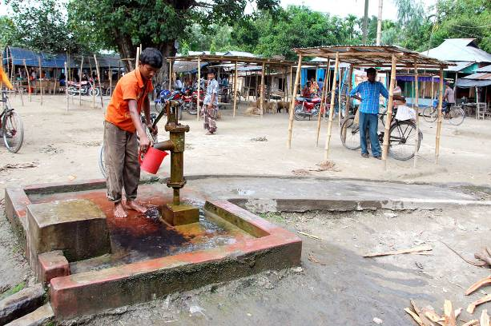
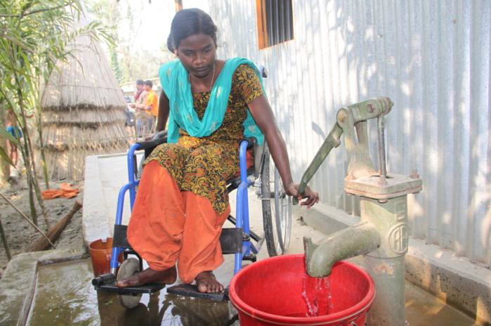
Key activities/Outputs
Cont..
accessible houses were constructed for PWD and their families
2 schools were adapted to be accessible flood shelters
48 accessible tube wells installed or adapted
Photo: CDD
An accessible community tube well
Photo: Shumon Ahmed/CDD
A young women using a tube well in her home
Notes:
18 accessible houses were constructed for PWD and their families, with accessible latrines and tube wells
2 schools were adapted to be accessible flood shelters with accessible latrines

Slide 19
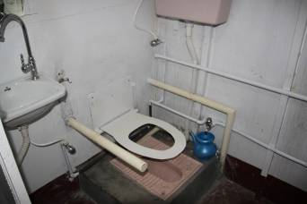
Key activities/Outputs
Cont..
A rescue boat with an accessible toilet was designed and constructed
Street theatre was used to raise awareness about disaster risk reduction and disability
Photo: CDD
Accessible toilet on the new rescue boat
Photo: CDD
Photo: CDD
Notes:
Interesting toilet because it combines handrails with a removable seat which can be lifted up if it is not needed (question if the seat is strong enough.... It is also interesting to note that there is still quite a bit step up to the toilet which may cause difficulties for people with mobility impairments - the handrails will help.
People with disabilities performed in street theatre

Slide 20
Participation of people with disabilities
PWD not just beneficiaries but included as active participants in the project
PWD and other community members sensitized to disaster risk reduction
Members of Disaster Management Committees were trained in disability awareness and disability inclusive DRR
PWD included in management structures: Ward Disaster Management Committee and WASH taskforce
Broader spin-off benefits for PWD and the community
Notes:
Project successfully included PWD by working simultaneously with PWD to build their capacity and confidence to participate and with the community/local government to create a supportive environment:
PWD:
briefed on the project and encouraged to participate – used home visits if needed to find people
received training (as did other community members) on vulnerability and capacity assessment and basic principles of DRR
Provided with assistive devices (e.g. a tri-cycle) to enable their participation
Others
During community consultations/meetings PWD were actively encouraged to participate and their opinions requested
Training on disability inclusion was incorporated into existing training on DRR – provided to Union Disaster Management Committee and Ward Disaster Management committee and local government reps – explained the benefits of including PWD and helped create an enabling environment for PWD to participate
A 10% quota was established to ensure PWD were included in Ward disaster management committee, and position of vice president/assistant secretary was set aside for PWD (a 30% quota in place for female participants)
Spin-off benefits
Local community is more receptive to considering the needs of PWD in general
People with disabilities are now being included into other development projects in the area
Dignity and self-esteem of PWD have improved because they feel they are making a worthwhile contribution to their communities

Slide 21
Challenges and lessons learnt
In the beginning, people with disabilities were seen by the community as beneficiaries in need of charity not contributors
It was difficult to include people with disabilities, particularly women, because they lacked confidence
Environmental barriers restricted people’s participation particularly in the wet season
Notes:
In the beginning people with disabilities were mostly seen by community as recipients rather than as contributors - The attitude of the community gradually started to change positively as the project focused on:
providing the community with appropriate information on disability
creating opportunities to interact more with the people with disabilities
promoting an environment where people with disabilities could demonstrate their potential.
It was difficult to include people with disabilities, particularly women, because they lacked confidence – they were more used to receiving services than making decisions. Spending time with them to encourage and support them was critical
Environmental barriers restricted the participation of the people with disabilities. The local path becomes very muddy during rainy season; access becomes extremely difficult, and near to impossible for people with disabilities. Assistive devices helped but this was still very difficult.
Any questions?

Slide 22
Key Messages
There are different levels of inclusion – some is better than none
Think about inclusion of PWD as active participants and in decision making process, not just as beneficiaries
Partner with DPOs or other disability organisations
Consider people with disabilities in project design from the start rather than trying to retrofit inclusion into the design.
Remember the twin track approach

