Slide 1
Participant Poll:
Please join the pre-presentation poll indicating your experience in HIV and WASH programming. This will assist us in setting the pace for the presentation and assess the need to cover basic concepts:
HIV
WASH
HIV & WASH
Other
Notes:
The purpose of the poll is to assess if a lot of people have WASH only experience. If so, there is scope to provide more detail around some of the basic HIV concepts.

Slide 2
HIV Inclusive WASH Programming
Centre for International Health
Contact: lucina@burnet.edu.au
Notes:
Acknowledgements
Adapted and updated version 2011 WASH conference presentation by Lisa Natoli.
Co-facilitator Julia and Burnet Colleagues for comments.
Draws on a range of resources developed by other agencies including USAID, WHO and WaterAID.
Reference listed at the end.
Ask questions and raise issues along the way.
Included logical points to pause for comments and questions on the chat and mic.

Slide 3
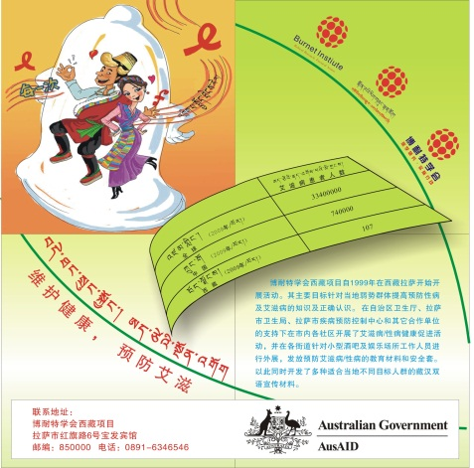
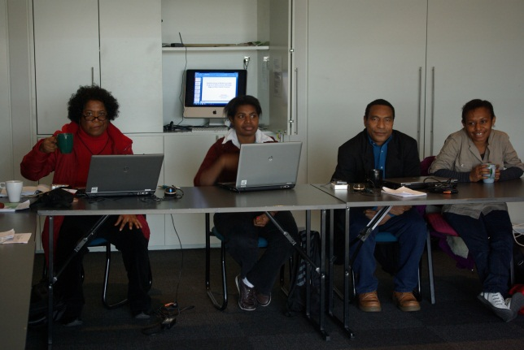
What is the Burnet Institute?
Medical Research
Public Health
Non-Government Organisation
Tertiary Education & Short-Course Provider
Burnet Institute
Tibet ANCP HIV Prevention Project – Tibetan Language IEC Materials
Hepatitis B under an electron microscope, many thousandths of its size.
Australian Leadership Awards - Drug & Alcohol Research Training Program PNG 2011
www.burnet.edu.au
Notes:
Our technical expertise includes:
Infectious diseases (viruses, other sexually-transmitted infections and malaria)
Immunology (development of vaccines and immunotherapies)
Risk factors associated with infectious diseases (especially drug and alcohol use)
Start a little about he Burnet – work areas include:
HIV, maternal and child health (including in health systems, vaccinations and vaccine development, and malaria)
Adolescent health (including drug and alcohol studies, hepatitis and sexual health)
Emerging infectious diseases (such as influenza)
Me - I have been at the Burnet Institute for almost seven years working largely in the area of harm reduction - initially with a focus on HIV prevention among IDU in Vietnam and later with a focus on drug and alcohol use in the Pacific region. First time as a presenter in this format.

Slide 4
Session Overview
HIV Basics
WHY?
integrate HIV into WASH programs?
integrate WASH into HIV programs?
WHAT?
are the specific WASH needs of people living with HIV and AIDS
are the priority WASH practices for integration
are the key considerations for integrating HIV into WASH programmes
HOW?
can we integrate the two types of program
Notes:
First of two sessions – goal is to provide some of the science on HIV around Risk, Transmission and Management
The second session will provide more specific examples of how WASH and HIV practices have been integrated – to promote discussion, this session will raise some questions on this process and provide some examples of where we might have done it without necessarily highlighting the how…
Pause for Questions

Slide 5
Basic Program Components
HIV & AIDS
WASH
Prevention
Treatment
Care
Water Availability
Water Quality
House Connection
Sanitation
Hygiene Promotion
Hand Washing
Notes:
In practice the responses are not as simple as listing these “basic” program components suggested
But these categories acted as a guide for thinking about how the two sectors interact
Questions/Comments
Next - talk a little about HIV.

Slide 6
A Snapshot of HIV

Slide 7
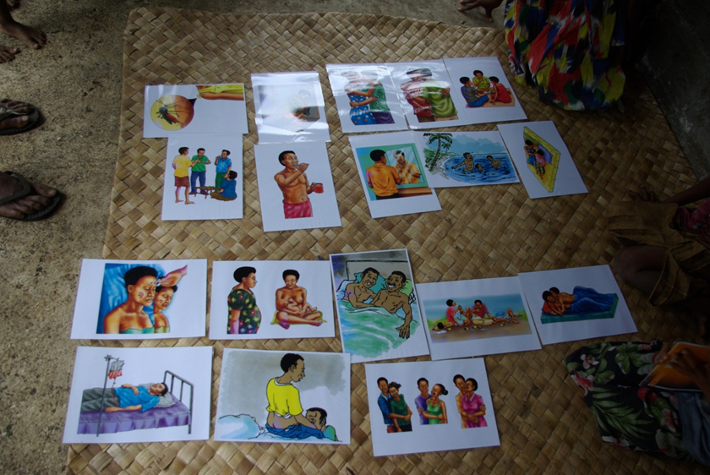
HIV Basics
Worldwide an estimated 33.3 million people live with HIV
Approx. 2.6 million new infections annually
Countless others affected by loss of family members and colleagues…
Greatest burden in Sub-Saharan Africa estimated 22.5 million HIV positive people (adults & children)
HIV burden often coincides with regions experiencing high levels of poverty and low levels of access to water and sanitation services.
Source: http://www.unaids.org/globalreport/Epi_slides.htm
Source: Lucina Schmich – FDG Risk Identification Activity – World Vision Health Cluster Evaluation 2011
Notes:
HIV versus AIDS
HIV (a virus) and AIDS (a clinical syndrome).
The virus that causes AIDS is the human immunodeficiency virus (HIV).
Most people with HIV do not have AIDS.
HIV prevention entails correct and consistent condom use, use of sterile injecting equipment, changes in social norms…
AIDS prevention entails cotrimoxazole, good nutrition, isoniazid prophylaxis (INH),…
Highlights the complexity behind my earlier list – that prevention, treatment and care for HIV and AIDS vary.
UNAIDS Terminology Guidelines on the website
Next

Slide 8
What are the transmission risks?
Highly Infectious
Blood, bloody fluids, body tissue
Semen, vaginal secretions
Fluid around the brain, spinal cord, unborn baby, heart, lungs, intestines, joints
(cerebrospinal, amniotic, pericardial, peritoneal, pleural, synovial fluids…
NB: these fluids are not normally shared!)
Moderately infectious
Breast milk
Not infectious
(unless visibly bloody)
Urine
Faeces
nasal secretions
saliva
gastric fluid
sputum
tears
sweat
Notes:
Urine and Faeces have particularly relevant for this discussion
Think management chronic diarrhoea
Note “Breast Milk”
Next

Slide 9
~ 7
infected during the pregnancy
~ 15
infected
at the time of delivery
~ 13
infected through breastfeeding – most in the early weeks
Notes:
Broad/emotional issue
Clear link to WASH: water, food prep, nutrition
~60% during pregnancy and at time of child birth
~40% breastfeeding
In 2010 updated HIV and infant feeding guidelines were published.
Emphasis = decision making context: National Guidance, availability ARVs, water, informed individual decision making
Paramount = process for providing guidance
Balancing prevention of HIV infection against other causes of child mortality (e.g. nutritionals issues and diarrhoeal disease as a key concern with complementary or replacement feeding
WASH issues start to emerge.
Next

Slide 10
How about…?
Open-mouth kissing One possible case
Oral sex Few possible cases
Women having sex with women Few possible cases
Using sex toys No documented cases
Tattoos and body piercing Documented cases
Human bite Few possible cases
Household contact Few possible cases
From health care workers One case
Notes:
Quickly other activities you may be curious about…
Last two have most obvious link to WASH – relate to care and support and management of illness
Next

Slide 11
In case you are wondering...
FLUID | KEY POINT
Urine & faeces | HIV has never been isolated in urine or faeces. (Water Environment Federation, 2000)
 | Urine and faeces quickly (in 1 hr) diminish infectivity of any HIV present. (Moore BE, 1993; Water Environment Federation, 2000)
 | Likely to be more virus in faeces of people with end stage AIDS. Risk to caregivers more likely to be due to other pathogens in faeces.
Menstrual blood | Menstrual blood of HIV+ women may contain virus at a higher load than regular blood (Reichelderfer PS et al, 2000)
Waste water | HIV infected blood introduced into de-chlorinated tap water had no detectable virus after 5 mins. (Moore BE, 1993)
Notes:
Emphasis on Evidence Why – Risk of Stigma
Basic WASH considerations identical to general population
BUT WASH need (esp water) in the context of prevention, care and support may be greater
However, by highlighting extra needs of positive people may inadvertently suggest transmission risks that don’t exist.
Not focussed on infection risk but on needs of potentially already marginalised groups with less access and improving health outcomes (could easily apply to other illness where diarrhoea is a side effect of treatment).
HIV specific paper on stigma and discrimination specific in the background reading docs.
People might like to share specific challenges in this area they have encountered during implementation of HIV and WASH programs on discussion Forum.
Pause for Questions
Next

Slide 12
So…
WHY integrate WASH into HIV & AIDS programmes?

Slide 13
Access = better chance for health
  (Bushen et al. 2004)
Susceptibility to Illness
  (Lule et al. 2005)
Treatment Effectiveness & wellbeing
quality of life and disease progression(?)
Understanding of the issue?
  (USAID/WHO 2010)
Notes:
From the Literature
Access: reduced access to water sanitation and hygiene are magnified for HIV positive and other immune compromised people - question does positive status mean people are purposefully excluded from services?
Susceptibility: ↑ susceptibility to opportunistic infections such as diarrhoea occurs among positive people - greater level of need
Treatment Effectiveness & Wellbeing: Diarrhoea reduces absorption of ARVs and essential nutrients – link to disease progression and
Quality of Life : Infections reduce quality of life and can speed progression from HIV to AIDS (?) – some discussion about this one and measuring it – what other factors might be in play.
Understanding – We are in need of ↑ evidence on WASH needs/health impacts of WASH interventions, for HIV+ people and their families
Next

Slide 14
Diarrhoeal Disease & HIV
Infectious diarrhoea among the most common illnesses in HIV positive people;
Among AIDS patients in developing countries as many as 95% have been reported to have diarrhoea
Chronic diarrhoea is a independent marker of poor prognosis in patients with AIDS
Notes:
Preventing Diarrhoea = easy starting point & justification for thinking about integration
Quick Search
1x Academic paper - 2007 paper by Becker et al in the American Journal of Tropical Hygiene
Note - little information available on the epidemiology of diarrhoeal disease among HIV positive people –
Research - treatment prophylaxis for diarrhoea in two regions in India + literature review on the links between HIV and diarrhoea
Findings
CD4 Count below 200 was strongly associated with diarrhoea – low CD4 indicator of compromised immune system = increased risk of disease (used as a guide for treatment)
Previous history of diarrhoea = increased risk (possible due to increased exposure in the home e.g. hygiene or lack of adequate treatment availability)
Prophylaxis when combined with home-based water chlorination and safe storage had a protective effect.
Significant limitations e.g. respondent bias on hygiene questions, lack of availability or ARVs in survey regions, some discussion of conflicting results with other surveys
BUT – need to increase understanding (emphasis on gathering the evidence for these interventions)
Next

Slide 15
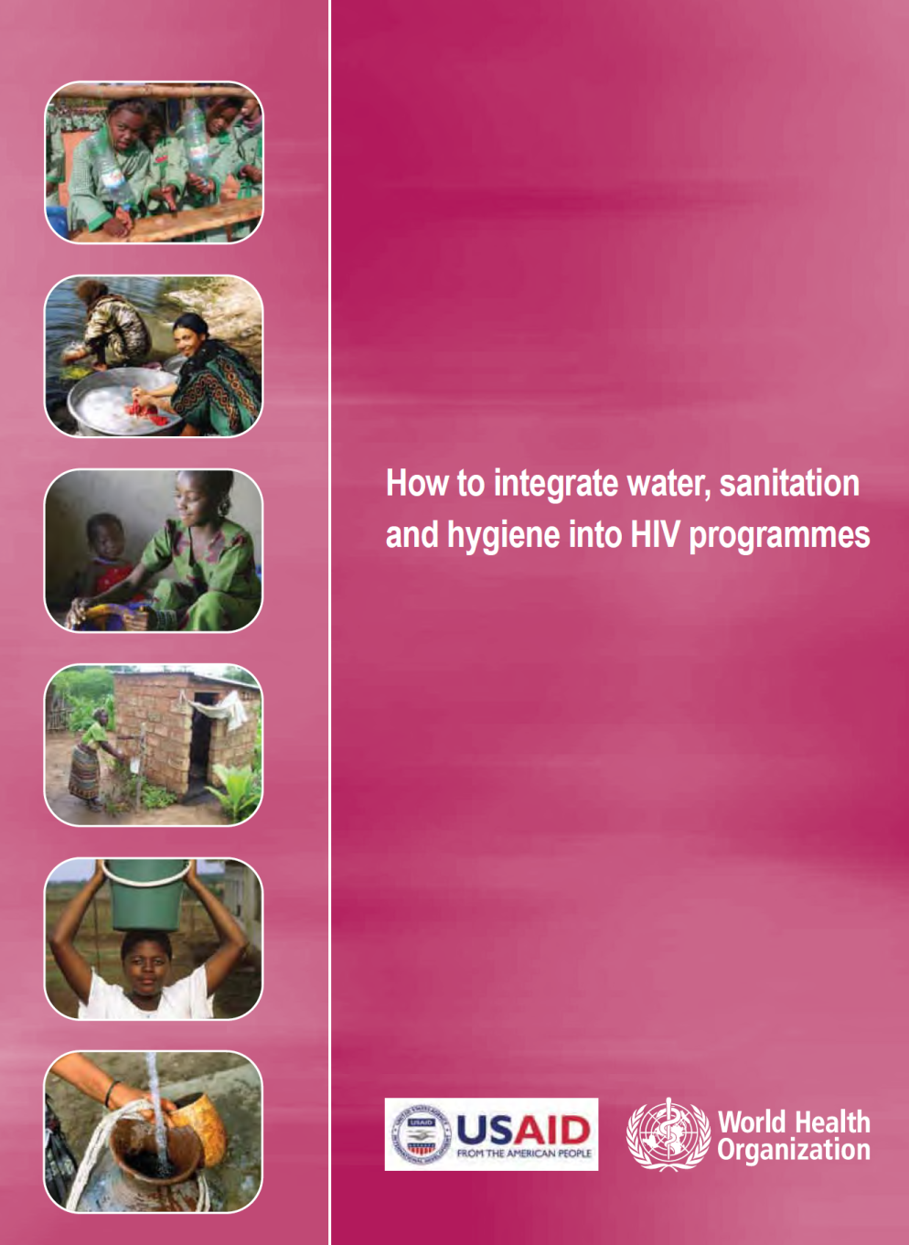
WASH practices can
  ↓ episodes & severity of
  diarrhoea among HIV+ people
  help to protect caregivers/other household members from diarrhoeal disease (& HIV)
A healthier/stronger household is more economically viable
and resilient to the challenges of HIV
Source: USAID/WHO 2010
Notes:
Linking back to WASH
Most common diseases for people with HIV are diarrhoeal and skin diseases – often waterborne and due to poor hygiene.
Diarrhoea is a major cause of morbidity and mortality in people living with HIV i.e. lack of access to clean water and good waste management = risk.
Meta-analysis:
44% reduction in diarrhoea with interventions (general population) focussed on hand washing with soap and HIV positive people have a twofold risk of experiencing diarrhoeal
39% reduction in diarrhoea where there is point of use household water treatment.
Point-of-use (POU) water treatment water treatment methods (physical, chemical and biological) to improve water quality for an intended use (drinking, bathing, washing, irrigation, etc), at the point of consumption instead of at a centralized scale (involving a distribution network).
WHO 2002.
Still need more evidence.
Next

Slide 16
WHY integrate HIV into WASH sector programmes?

Slide 17
Avoiding Silo Effects
Protecting Human Rights
Responding to Groups in Greatest Need
Ensuring Access
Filling Program Gaps
WATER
HEALTH
Source: USAID/WHO 2010
Notes:
Key point is Adding Value
Silo - Government Ministries often work in silos – balancing coordination and the need to be self-contained.
Human Rights - WASH is a basic human right (for everyone!); needs of HIV+ people often exceed those of general population.
Access - Family Units or houses without primary income earners are less able to pay for water/latrines - (capacity, cost, location other) - Fewer able bodied people in households means fewer people able to manage and engage with water/sanitation activities (Franks & Cleaver 2002)
Gap Filling - Most WASH related programmes do not address HIV/AIDS (Kamminga & Wegelin-Schuringa 2005)
Arguments basically the same for integration in both directions …. but one of the key benefits might be gateway opportunities provided by combining the two…
Next

Slide 18
Key considerations
Protecting sectoral human resources through HIV prevention and mitigation activities
Considering special hardware needs of those affected by HIV and AIDS in WASH programmes and activities, for example
  lengthening pump handles to make it easier to pump water
  building wells or latrines closer to HIV affected households
  building ramps or platforms for easier access
‘GIPA’ principles
Notes:
Key considerations for integrating HIV into WASH programs:
WASH teams may have positive people + opp to prevent transmission
Add Value – Increasing benefits that WASH programs provide to target communities x improved access
Special Needs – working with affected people to identify additional requirements in water = more comprehensive programs for WASH similar to including specific gender and disability related needs.
Basic Prevention Principles – WASH programs can provide the opportunity to dispel myths around transmission and risk for the general population
Gateway Opportunities – Community wells and bathing locations developed as part of WASH programing and used by different gender groups at different time may provide an entry point for discussion of taboo topics such as HIV transmission
Next

Slide 19
WHAT are the specific needs of people living with HIV?

Slide 20
Although WASH needs of HIV positive people exceed the needs of those who are uninfected, they often have less access to water and sanitation facilities than their neighbours
(Magrath and Tesfu 2006)
Notes:
Why?

Slide 21
Individual, Family, Community
WASH Needs
ACCESS to ADEQUATE AMOUNTS of GOOD QUALITY WATER for: drinking; taking ARVs; food preparation; ? replacement feeding; washing clothes; personal hygiene
ACCESS to SANITATION for safe handling and disposal of faeces and items soaked with menstrual blood
HYGIENE:
hand washing; menstrual management; food hygiene.
Notes:
Some general considerations in diagram form
Scenarios…
Next

Slide 22
What are the likely WASH needs of this family?
Doris lives in the western highlands of Papua New Guinea. She spends much of her time caring for her dependant husband, Fidelis.
*
Fidelis is chronically ill with AIDS related illnesses, and suffers from regular bouts of debilitating diarrhoea.
*
Doris found out she was HIV positive after being tested during an antenatal care visit early in 2010.
Baby William is now six months old and is HIV negative.
Notes:
General scenario
Individual and Family level water needs should be considered
Prevention – Baby (& Doris) – infant feeding
Prevention – Doris – progression to AIDS
Care an support – Fidelis, Doris & Baby – Community who can help Doris – burden will likely fall on her?
Logistical, Environmental, Medical - carrying water, volume, time, location
HIV infant feeding guidelines,
National Policy on breastfeeding
Options, Advice, Choice
Physical considerations
Who will cart the water if it is not available near their home?
What about risk of assault or rape at water facilities located far from Home – HIV Risk Mapping.

Slide 23
What about the WASH needs of other marginalised groups?
Notes:
Stigma and discrimination is exacerbated for people who sell sex or inject drugs
behaviour is often illegal
people are judgemental (pregnant woman)
Why should they have access (special treatment) = equity arguments
Why are there limits to access e.g. may reflect “unstable” or impermanent accommodation arrangements i.e. not stigma
Scenarios…

Slide 24
An HIV prevention project is working with local partners to provide outreach services and information, education, communication (IEC) materials to sex workers in Tibet. The project has an emphasis on behaviour change and is a success in that the people targeted by the intervention report adopting 100% condom use. BUT, during Most Significant Change story collection a participant reported that they no longer need to wash between sex partners…
Notes:
HIV Prevention
Most Significant Change story
Unexpected outcome of the of HIV prevention program with no specific WASH focus.
Condom use message changed perceptions about hygiene practices - what is the outcome of changed practice?
Thinking through issues:
access to water tends to be limited in settings where sex work occurs
Douching (flushing vagina) not recommended but some cultural practice
But what are general implications
Search for resources = guidance on hygiene in brothels – discussion hygiene as occupational health and safety issue.
Raises interesting questions on terminology (do basic HIV care and support programs already address some WASH issues but call then something else? What about prevention programs?)
NSW also websites for sex workers: http://www.prostitutie.nl/index.php?id=29&L=1
Next

Slide 25
Van regularly injects drugs behind a railway station. She has been injecting heroin with her partner for more than two years but has managed to stay HIV negative. She does not share injecting equipment and practices 100% condom use partly due to services and information provided as part of the local HIV peer education outreach program. The couple “sleeps rough”…
Notes:
HIV Prevention
Very marginalised group – same basic needs at whole community
Not likely to be reached in ordinary community WASH programs as excluded from “community”
Have a network i.e. peer workers and other people who inject = opportunity for intervention
Hand washing before injecting is protective against many infections, including blood borne viruses.
Injectable drugs are often mixed with water, if that water is not sterile it can cause injecting related injury and disease.
Access to safe water for people who inject drugs is critical, as it reduces a range of complications.
I wasn’t able to locate the specific data in time but for many programs sterile water is an optional extra – will post any specific guidance on the Forum once I find it.
Next

Slide 26
Comparison of Daily Water Needs
Individual Basic Daily Water Needs – Well Person | Person Living with HIV Additional Needs
20 l/day min - basic water for drinking, food preparation, laundering & personal hygiene | 20-80* l/day - hygiene needs of person living with HIV, laundering clothes and bedding.
 | 1.5 l/day - water for taking ARVs.
 | 1 l/day- water for replacement feeding of infants < 6 mths (w/o cleaning equipment)
 | 2 l/day- water for replacement feeding of infants > 6 mths (w/o cleaning)
 | ? Person who injects drugs 2-4 times daily
Source: Adapted from USAID/WHO 2010 | Amount in litres (l) per day
Notes:
Source: USAID/WHO 2010

Slide 27
Priority WASH practices to integrate into HIV & AIDS programmes
Treat drinking water
Store treated drinking water safely
Promote hand washing
Handle and dispose of faeces safely
Manage menstruation
Prepare, handle and store food safely
Promote personal cleanliness
Source: USAID/WHO 2010
Notes:
Query - how many of these are handled as part of basic care and support and called something else i.e. infection control – where are the real gaps… most likely in the special needs.

Slide 28
Take Home Messages
Basic WASH needs are identical for HIV positive and HIV negative people
BUT
Positive people may have additional needs;
Integrating WASH practices may improve effectiveness of treatment and care programs;
Integrating HIV practices may assist in meeting previously unmet needs
AND
Evidence is essential…
Notes:
Especially in preventing stigma and discrimination
Things I missed out – BCC principles, income earning opps in WASH programs for positive people in addition to potential to support nutrition requirements…
Other?

Slide 29
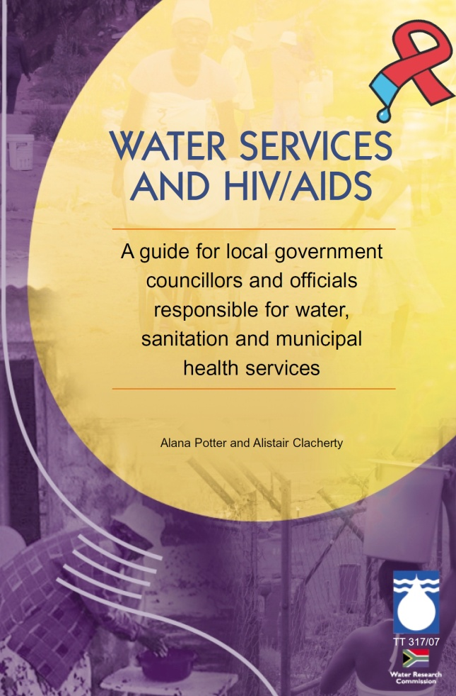
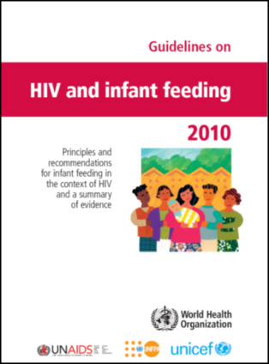
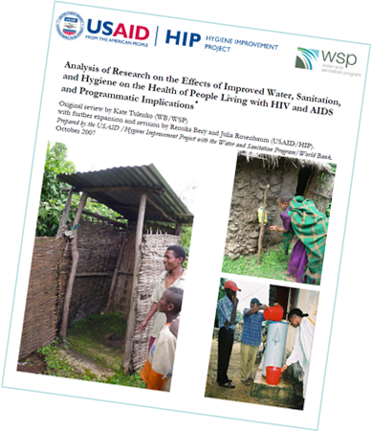
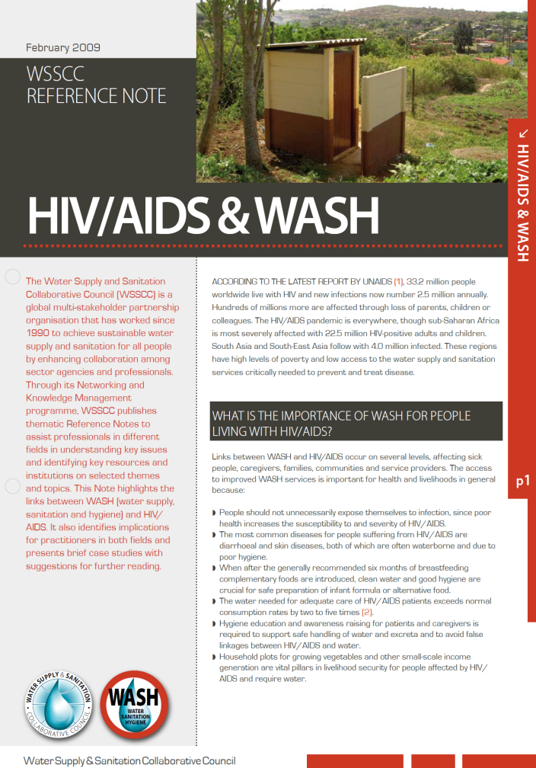
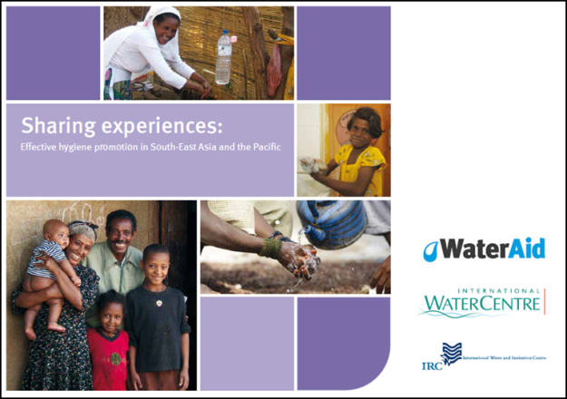

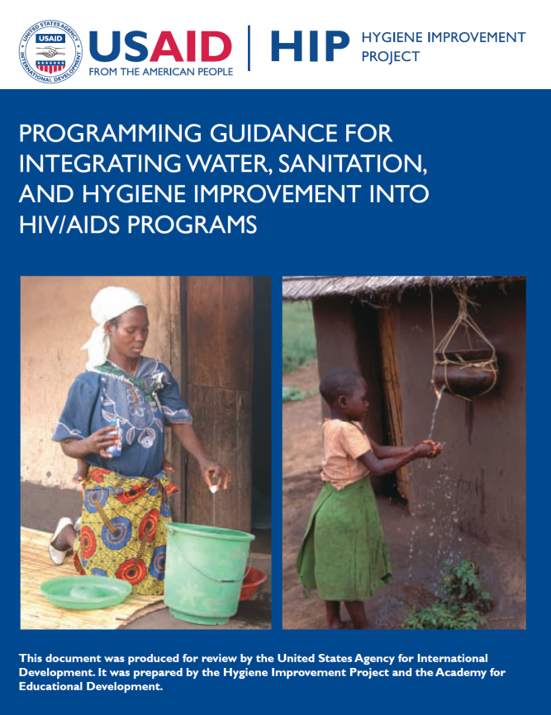

Resources
Notes:
Increasing range of resources available addressing WASH needs in HIV programming – Julia from FHI 360 who will be running the second live session was involved in developing a number of these and can present on some of the more practical issues around implementation.

Slide 30
Resources
General
  http://www.aidsmap.com/
  http://www.thebody.com/
Basic facts
  http://www.unaids.org/globalreport/Epi_slides.htm
  http://www.cdcnpin.org/scripts/hiv/faq.asp
  http://www.aidsmap.com/en/docs/E37EAE51-794C-4A1B-A13A-4A697702F3D8.asp
Evidence that HIV causes AIDS
  http://www.avert.org/evidence.htm
Origins of HIV
  http://www.retroconference.org/2007/data/files/webpage_for_CROI.htm
History of the epidemic and response
  http://www.pbs.org/wgbh/pages/frontline/aids/
WHO HIV treatment guidelines
  http://www.who.int/hiv/pub/guidelines/adult/en/index.html
HIV & WASH
  http://www.wsscc.org/topics/hot-topics/hiv/aids-and-wash
  http://www.hip.watsan.net/page/4489
  Publications & Resources - http://www.hip.watsan.net/page/4142
  http://www.wateraid.org/uk/what_we_do/how_we_work/equity_and_inclusion/8321.asp
  http://www.watercentre.org/projects/sharing-experiences-hygiene

